Slide 1
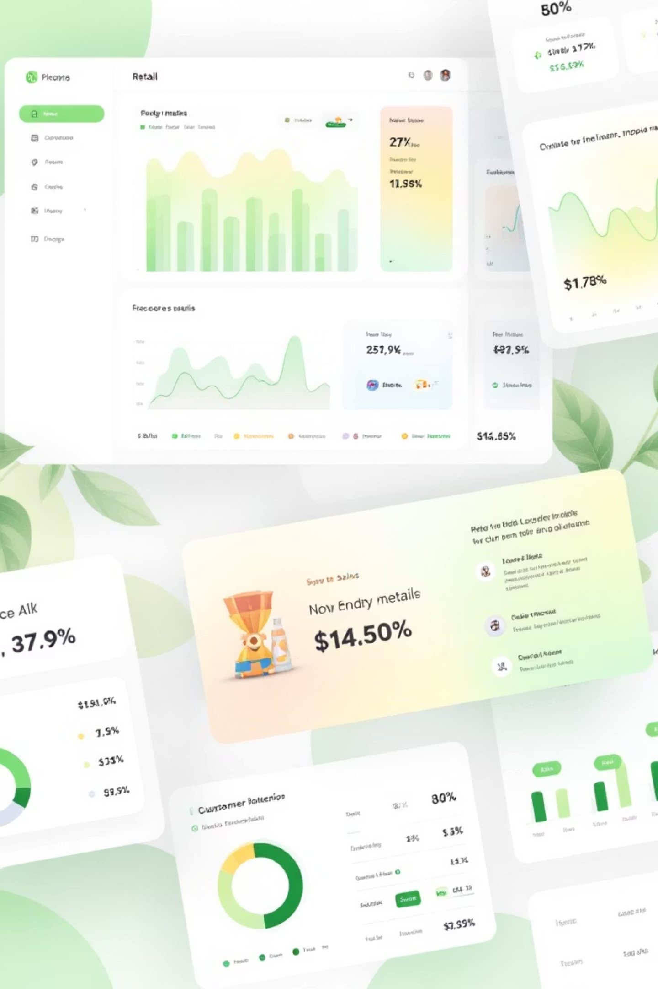
Customer Shopping Behavior Analysis
Uncovering insights from 3,900 purchases to guide strategic business decisions

Slide 2
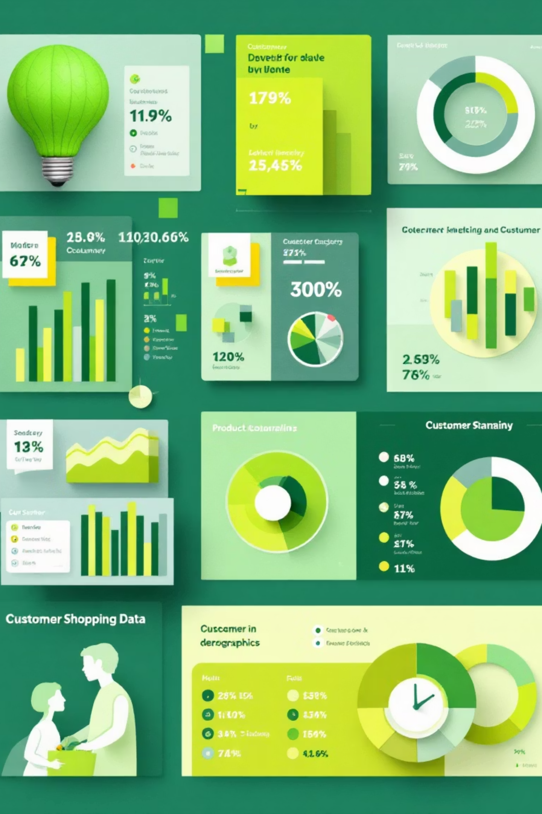
DATASET OVERVIEW
The Foundation
3,900
18
50
Total Purchases
Data Points
Locations
Transactions analyzed
Features per transaction
Geographic coverage
4
Categories
Product segments
Comprehensive dataset covering demographics, purchase details, and shopping behavior across multiple dimensions

Slide 3

PYTHON ANALYSIS
Data Preparation & Cleaning
01
02
03
Data Loading
Missing Data
Standardization
Imported dataset using pandas, explored structure with df.info() and summary statistics
Imputed 37 missing Review Rating values using median by category
Renamed columns to snake_case, verified data consistency
04
05
Feature Engineering
Database Integration
Created age_group bins and purchase_frequency_days columns
Connected to PostgreSQL for advanced SQL analysis

Slide 4

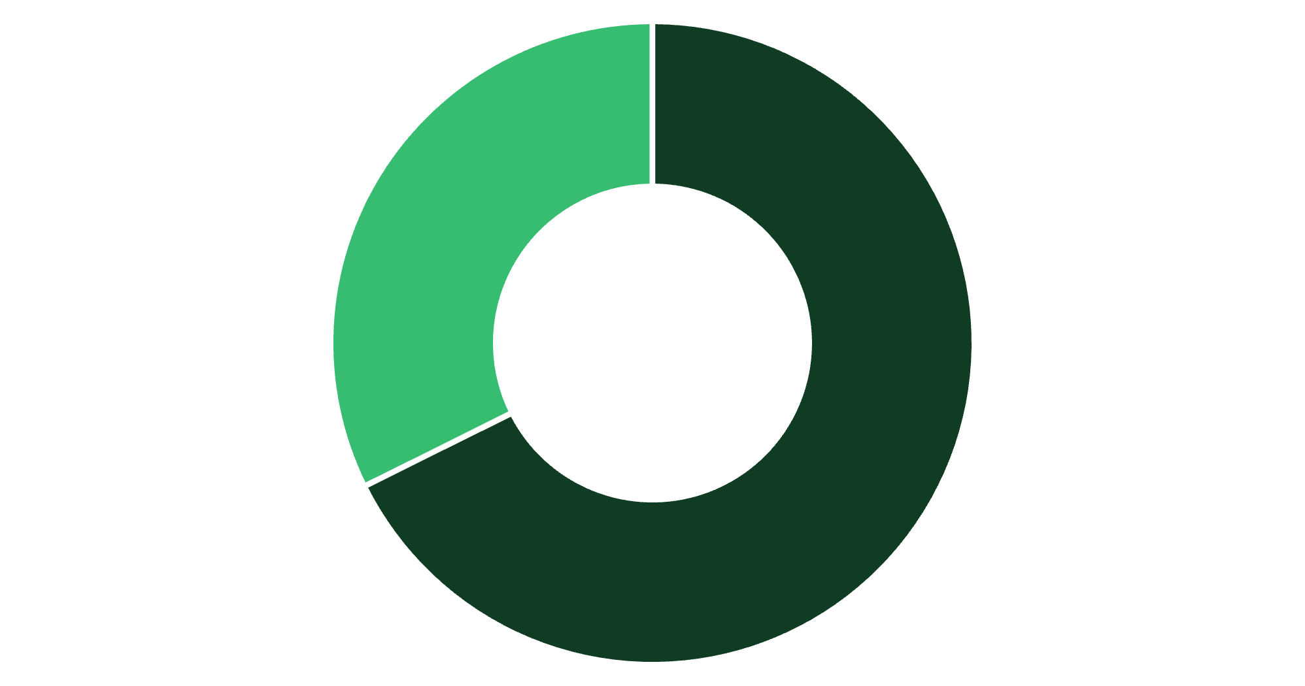
SQL INSIGHTS
Revenue by Gender
Male Dominance
Male customers generate 68% of total revenue, more than double female contribution
Strategic opportunity for targeted female customer acquisition campaigns
Male
Female

Slide 5



Customer Segmentation Insights
New
1
83 customers
Returning
2
701 customers
Loyal
3
3,116 customers
80% of customers are loyal with strong repeat purchase behavior

Slide 6
PRODUCT PERFORMANCE
Top-Rated Products
77%
77%
76%
Gloves
Sandals
Boots
3.86 average rating
3.84 average rating
3.82 average rating
76%
76%
Hat
Skirt
3.80 average rating
3.78 average rating

Slide 7

Subscription Analysis
Subscribers
Non-Subscribers
1,053 customers
2,847 customers
Average spend: $59.49
Average spend: $59.87
Total revenue: $62,645
Total revenue: $170,436
Repeat Buyers
958 subscribers with 5+ purchases
Opportunity
2,518 non-subscribers with high purchase frequency

Slide 8


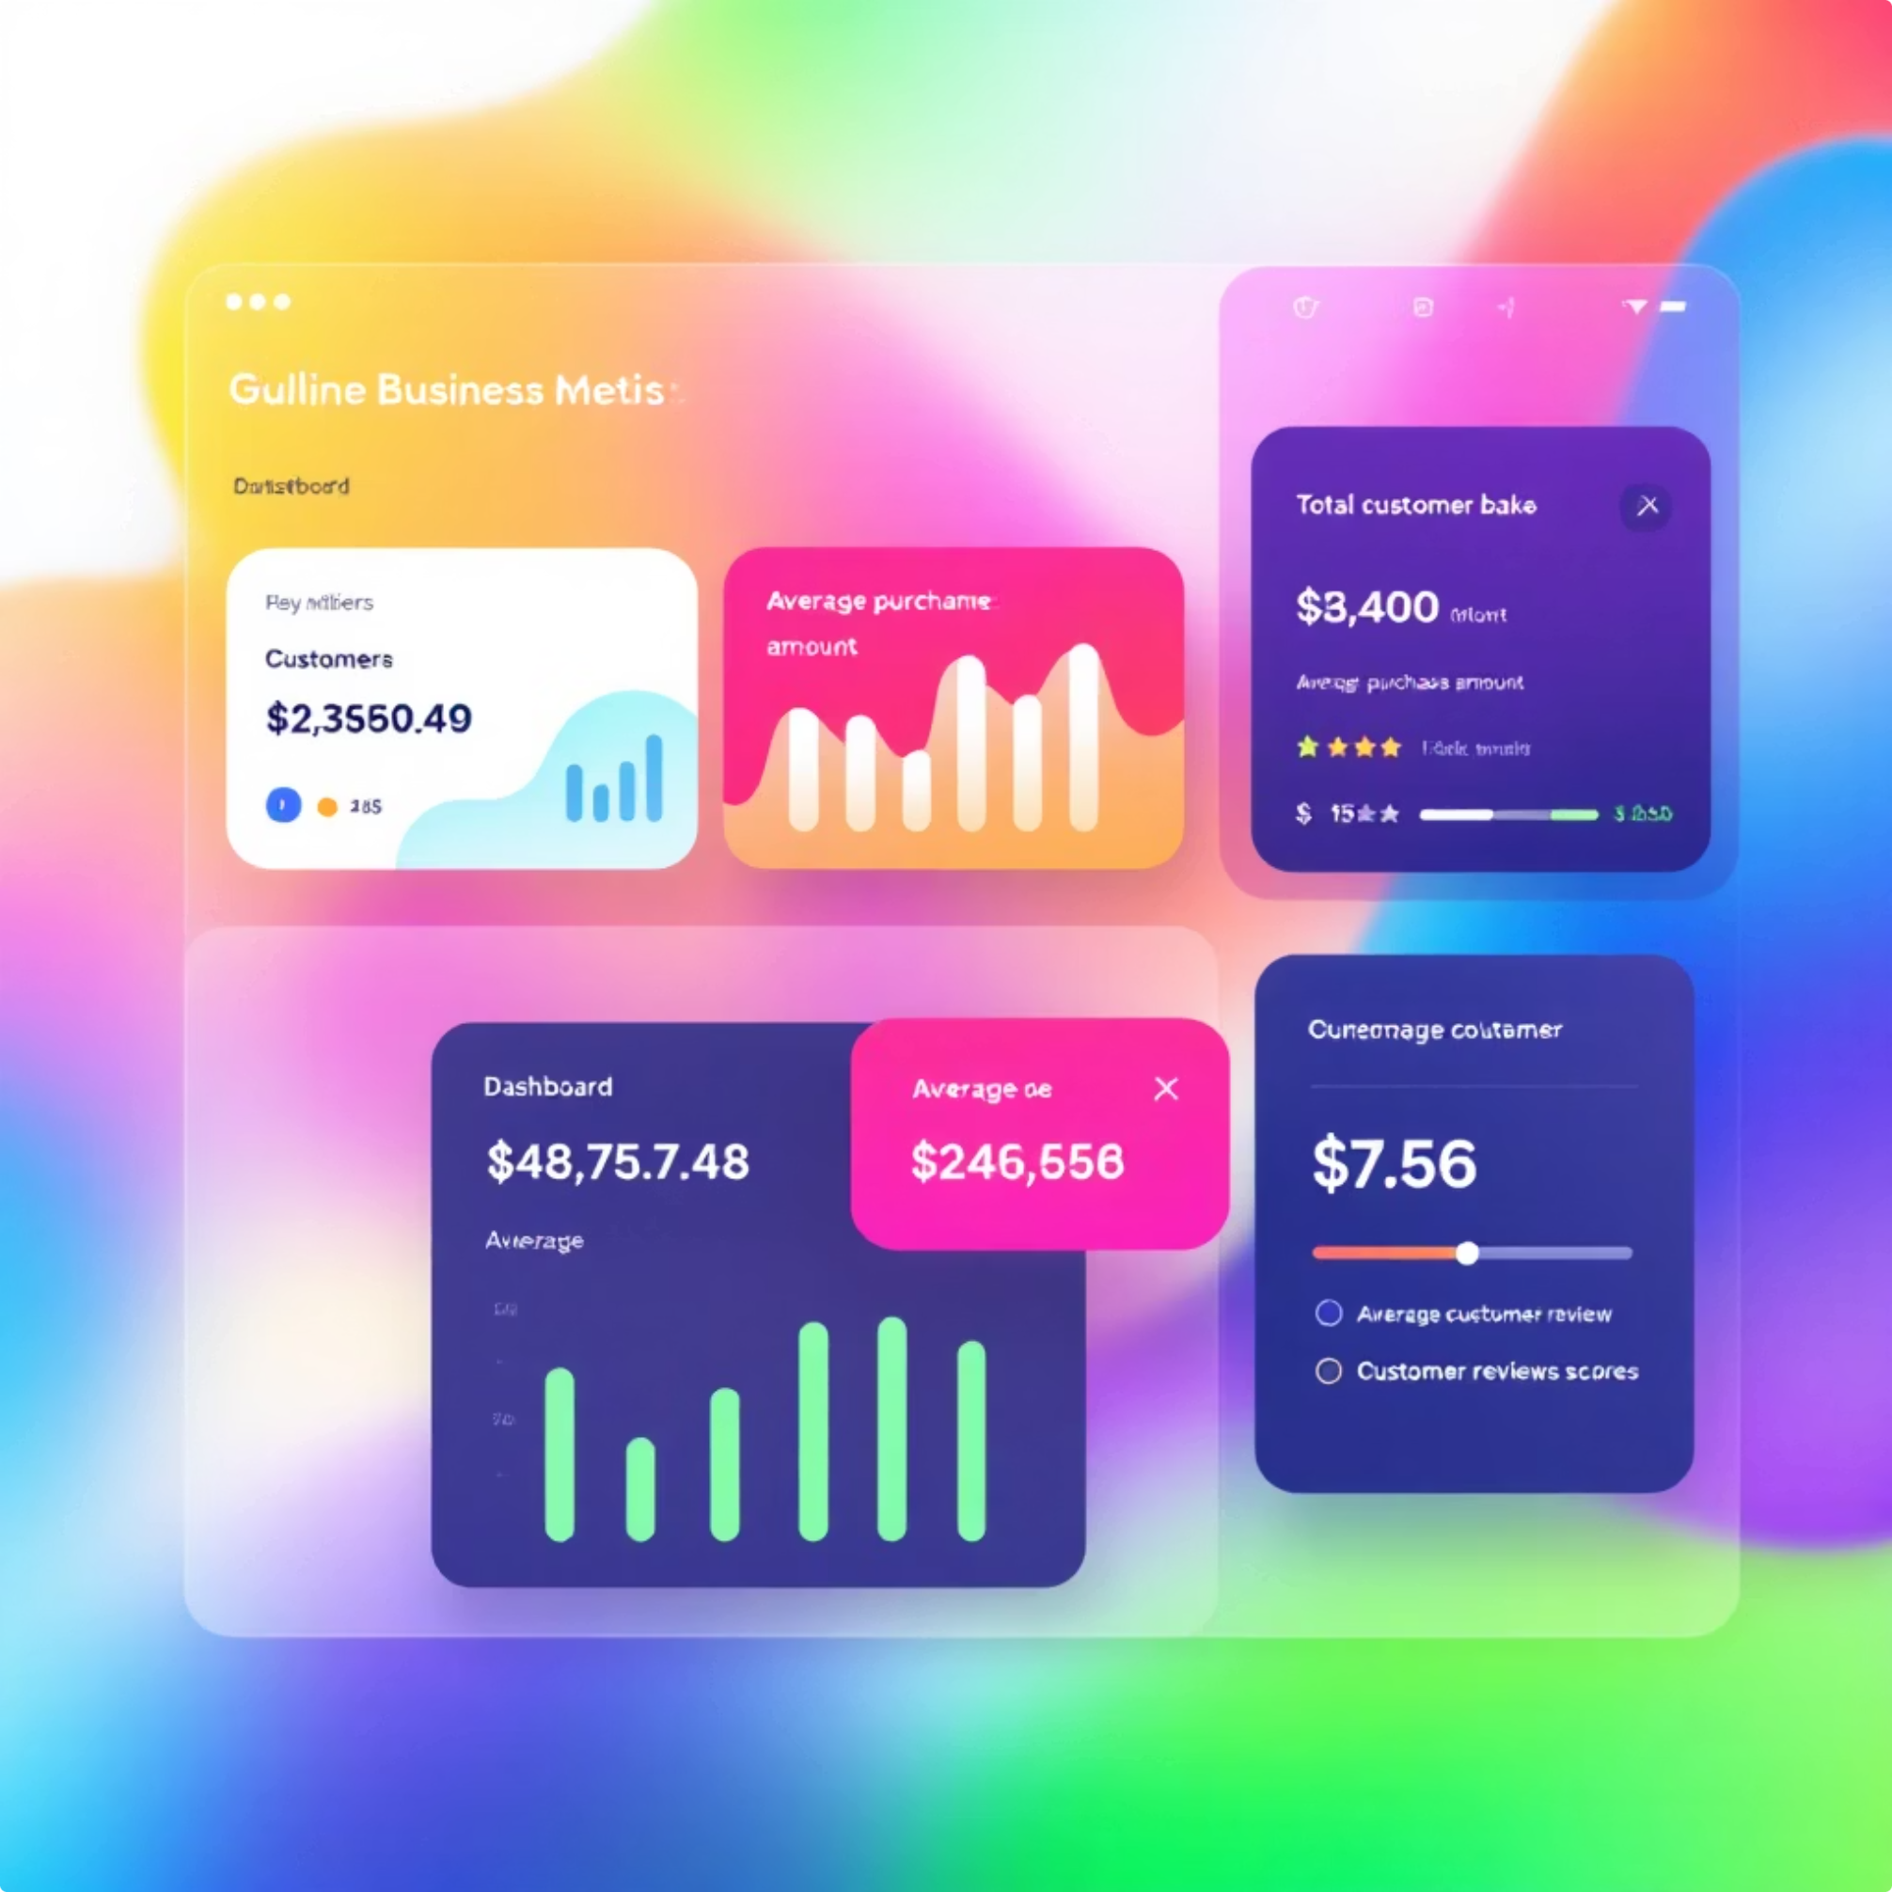



DASHBOARD
Power BI Dashboard Overview
3.9K Customers
Total customer base analyzed
$59.76 Average
Purchase amount per transaction
3.75 Rating
Average customer review score

Slide 9
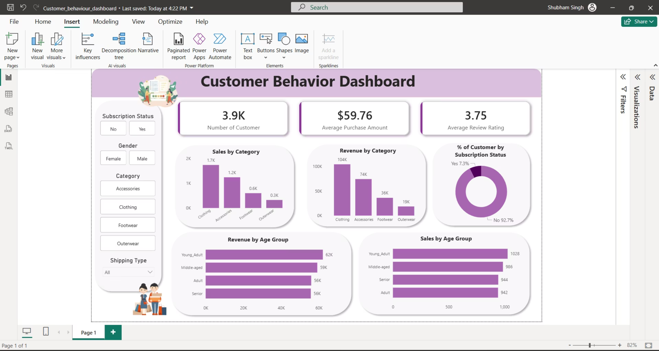
Dashboard Screen Shot

Slide 10
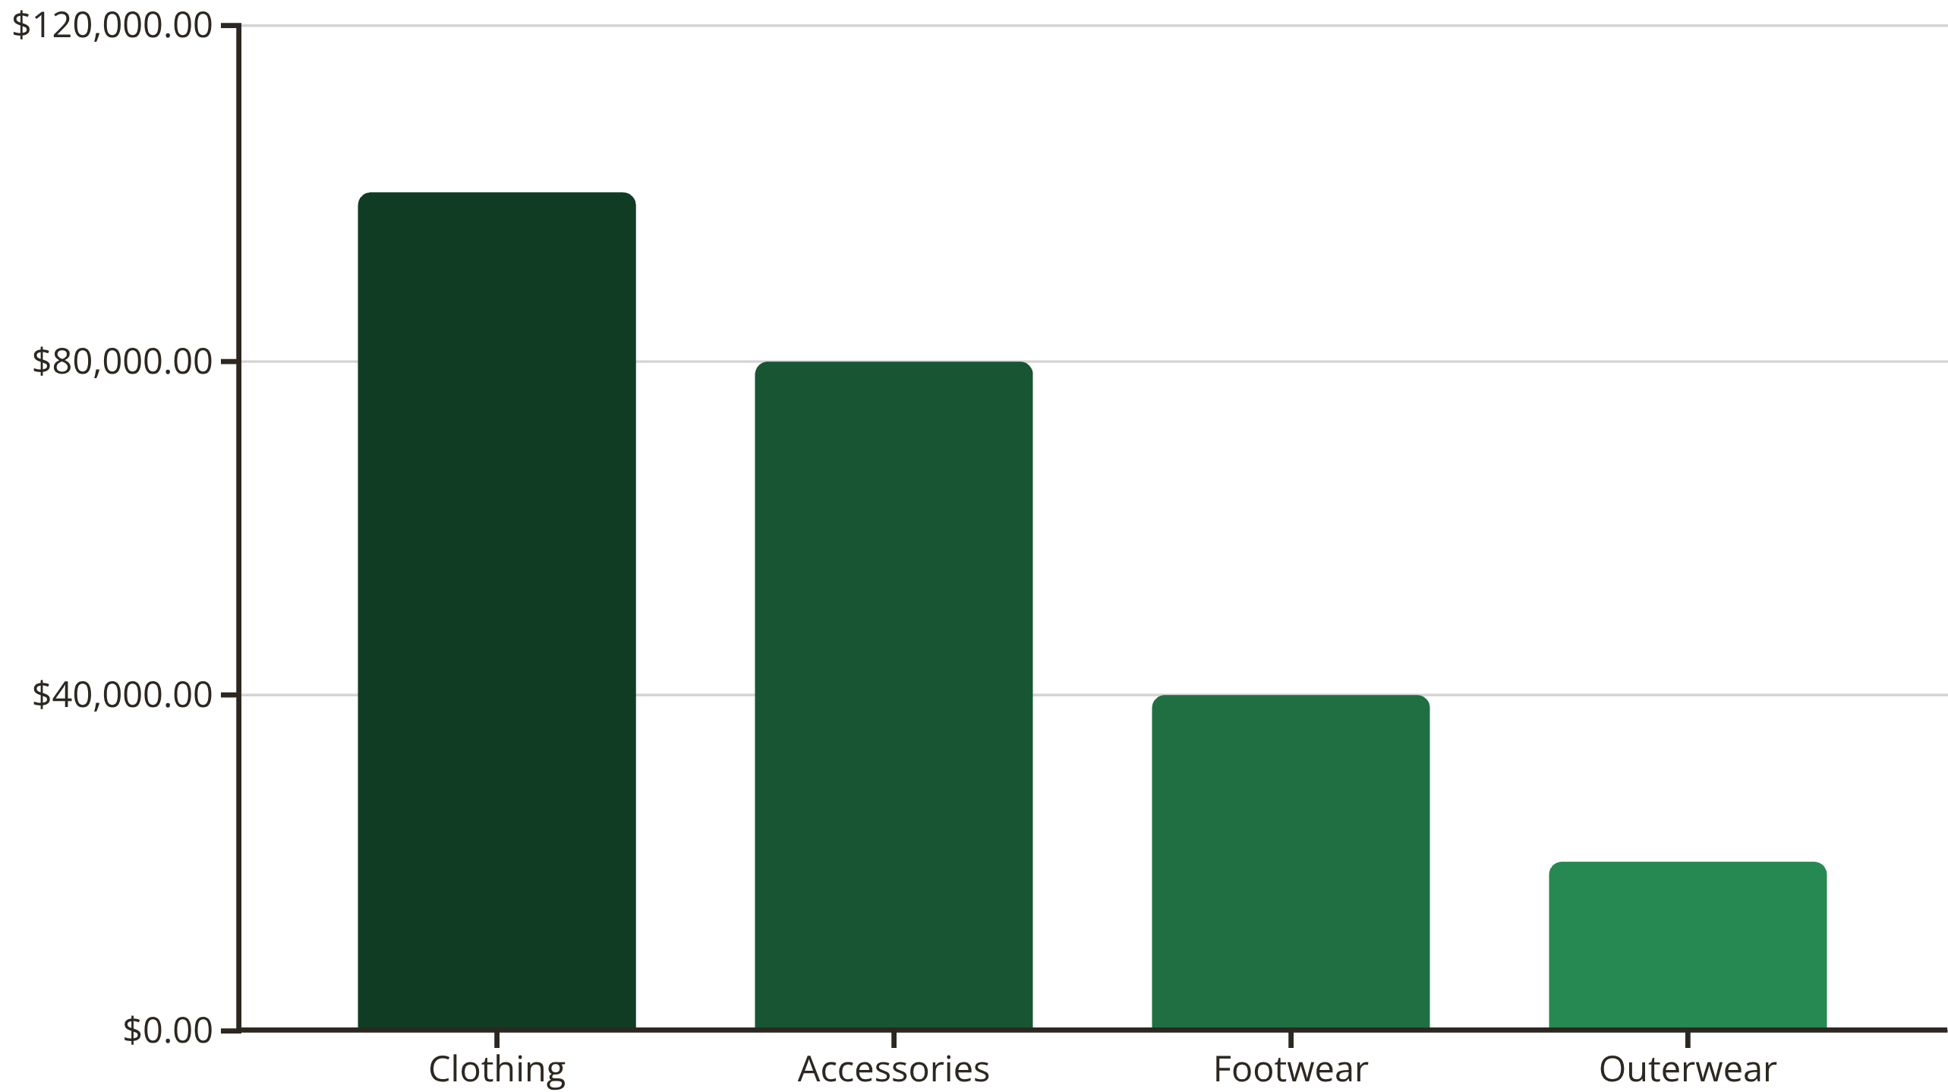
Revenue Distribution
Category Leaders
Age Groups
Clothing dominates with 43% of total revenue
Young Adults lead at $62K, followed by Middle-aged at $59K

Slide 11

ACTION PLAN
Strategic Recommendations
Boost Subscriptions
1
Promote exclusive benefits to convert 2,518 high-frequency non-subscribers
Loyalty Programs
2
Reward repeat buyers to strengthen the 80% loyal customer base
Discount Strategy
3
Balance promotional sales with margin control—839 customers spend above average with discounts
Product Positioning
4
Highlight top-rated items (Gloves, Sandals, Boots) in marketing campaigns
Targeted Marketing
5
Focus on Young Adults ($62K revenue) and male customers (68% of revenue)

